Slide 1
welcome to our project presentation
Anurag kohli
Btech cse ( 7th )
2202862

Slide 2

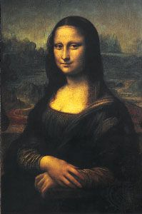
Presentation on ArtStore: An E-Commerce Platform for Art Reproductions

Slide 3
Overview
Introduction
Problem Statement
Objectives
Platform Used
System Design
Key Features
Challenges
Conclusion

Slide 4
Introduction
ArtStore is an e-commerce platform aimed at selling high-quality art reproductions.
Artists and customers can connect through this platform.
Provides a convenient online marketplace for purchasing artwork.

Slide 5
Problem Statement
Need for ArtStore:
Difficulty for new and upcoming artists to find a marketplace.
Limited availability of affordable art reproductions for customers.
Lack of a dedicated platform for buying and selling art reproductions.

Slide 6
Objectives
Main Goal: Build an e-commerce website for selling art reproductions.
Key Objectives:
Offer an easy-to-use interface for buyers and sellers.
Ensure secure transactions and buyer protection.
Develop a scalable platform that can host numerous artworks.

Slide 7
Platform Used
Languages: PHP, HTML, CSS, JavaScript.
Database: MySQL for storing user data, art listings, and transaction details.
Frameworks: Laravel or CodeIgniter (PHP Framework).
Payment Integration: PayPal, Stripe for online payments.

Slide 8
System Design
User Interface: Clean and intuitive design focused on the artwork display.
Backend: Secure user authentication, inventory management for art pieces.
Database: Efficient storage of product images, descriptions, and pricing.
Include Diagram: Show flow between frontend, backend, and database.

Slide 9
Key Features – Art Listing
Artists can easily upload images of their artwork.
Search Functionality: Filter by category, artist, price.\
Product Pages: High-quality image previews, descriptions, and pricing.

Slide 10
Key Features – User Accounts
Artist Accounts: Allows for uploading and managing their art.
Buyer Accounts: Tracks orders, previous purchases, and Wishlist.
Admin Dashboard: For overseeing transactions and user activity.

Slide 11
Key Features – Payment and Security
Secure Payments: Integration with PayPal, Stripe, and credit card options.
User Data Protection: Secure encryption of sensitive information.

Slide 12
Challenges
Scalability: Ensuring the platform can handle many users without slowdowns.
Competition: Standing out in a market crowded with art platforms.
Shipping Logistics: Ensuring art is delivered safely without damage.

Slide 13
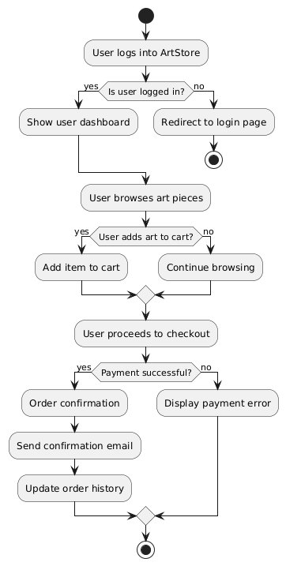
System Flowchart

Slide 14
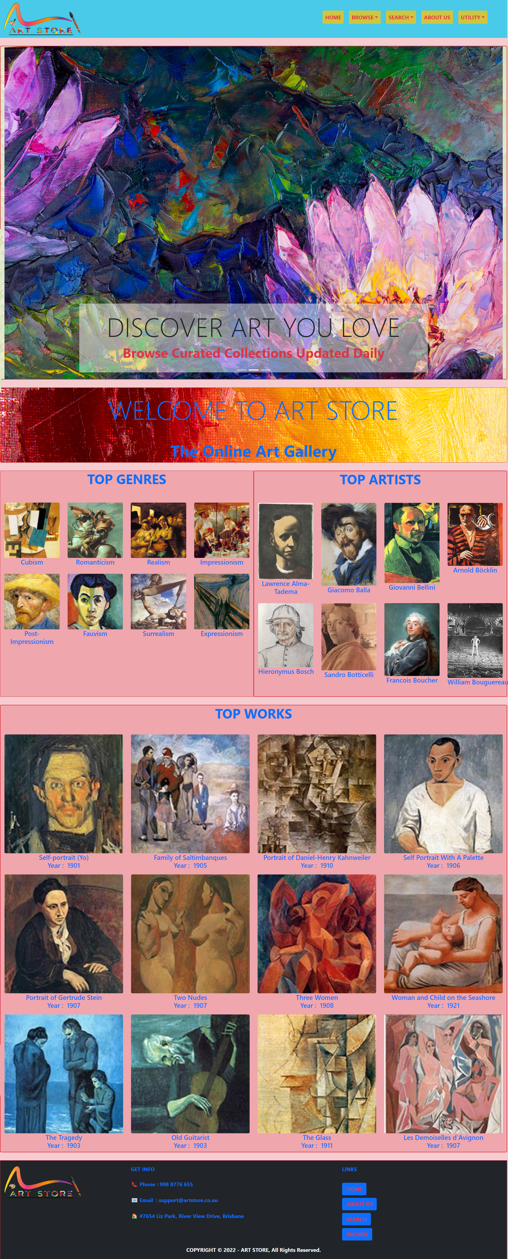
Screenshots – Homepage

Slide 15
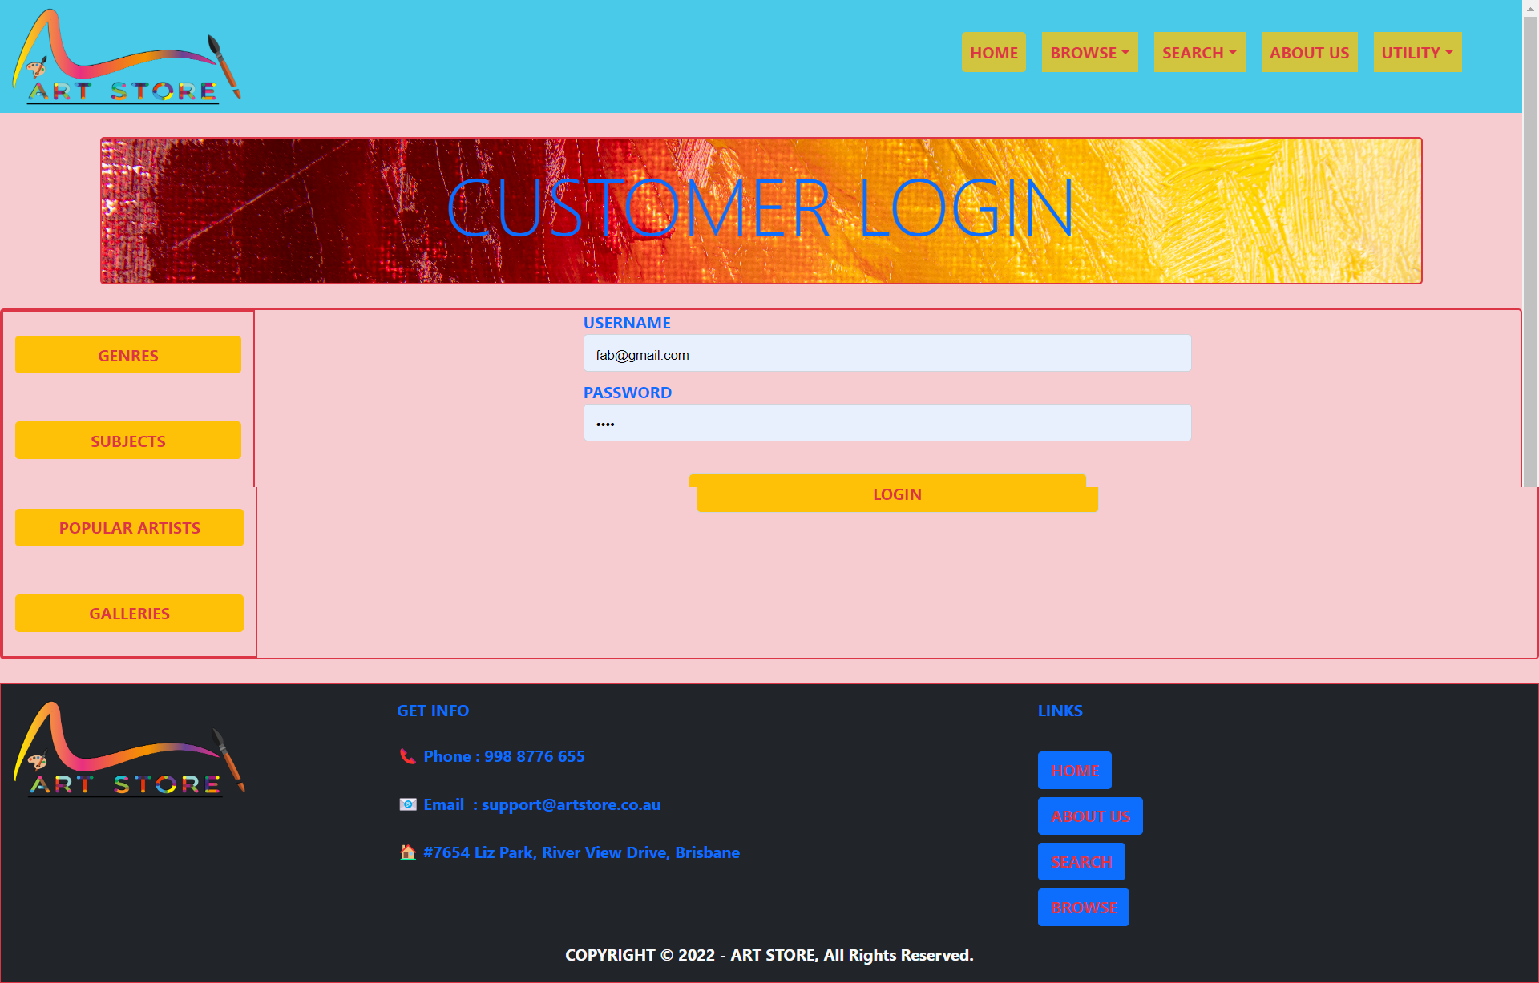
Screenshots – Login page

Slide 16
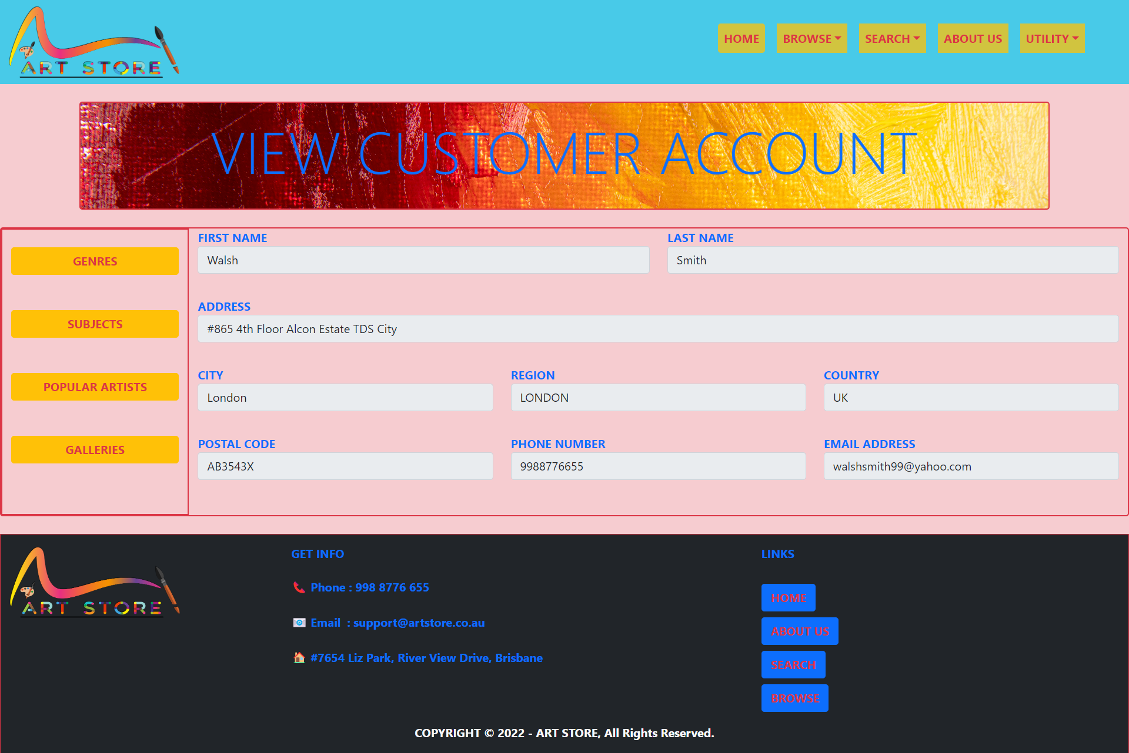
Screenshots – User Account Dashboard

Slide 17
LIVE DEMO!

Slide 18
Future Scope
Expansion: Add more categories (e.g., sculptures, digital art).
Global Reach: Integration of multi-language and currency support.
Mobile App: A mobile version for a seamless shopping experience on the go.

Slide 19
Conclusion
ArtStore offers a platform where art lovers can easily find and purchase beautiful, high-quality reproductions.
Artists can sell their works globally without the limitations of physical galleries

Slide 20
THANK YOU!

